Slide 1
Ted talks views prediction
B. Pravallika
221FA14017
BI- A

Slide 2
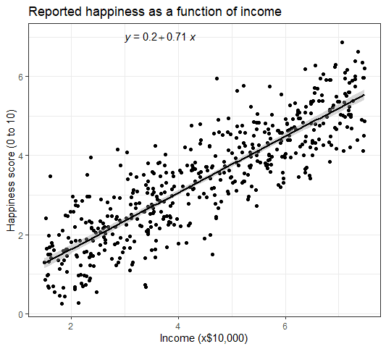

Linear Regression
Linear Regression is a commonly used type of predictive analysis. Linear Regression is a statistical approach for modelling the relationship between a dependent variable and a given set of independent variables. It is predicted that a straight line can be used to approximate the relationship. The goal of linear regression is to identify the line that minimizes the discrepancies between the observed data points and the line’s anticipated values.
There are two types of linear regression.
Simple Linear Regression
Multiple Linear Regression

Slide 3

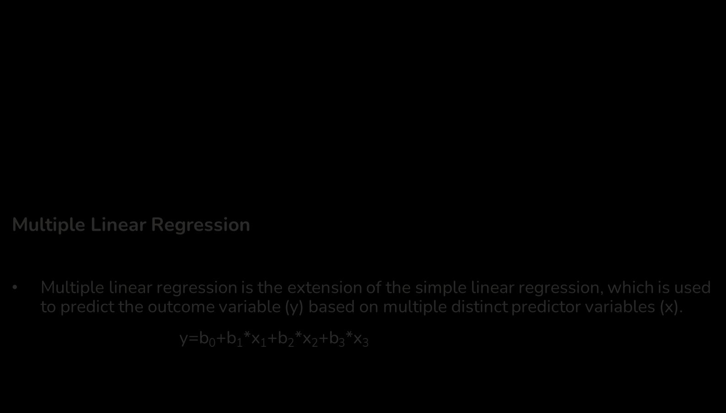
Simple Linear Regression
Linear regression algorithm shows a linear relationship between a dependent (y) and one or more independent (y) variables.
It is a statistical method that is used for predictive analysis.
y= β $⃘+\text{β}1X+ℇ$
Multiple Linear Regression
Multiple linear regression is the extension of the simple linear regression, which is used to predict the outcome variable (y) based on multiple distinct predictor variables (x).
y=b₀+b₁*x₁+b₂*x₂+b₃*x₃

Slide 4
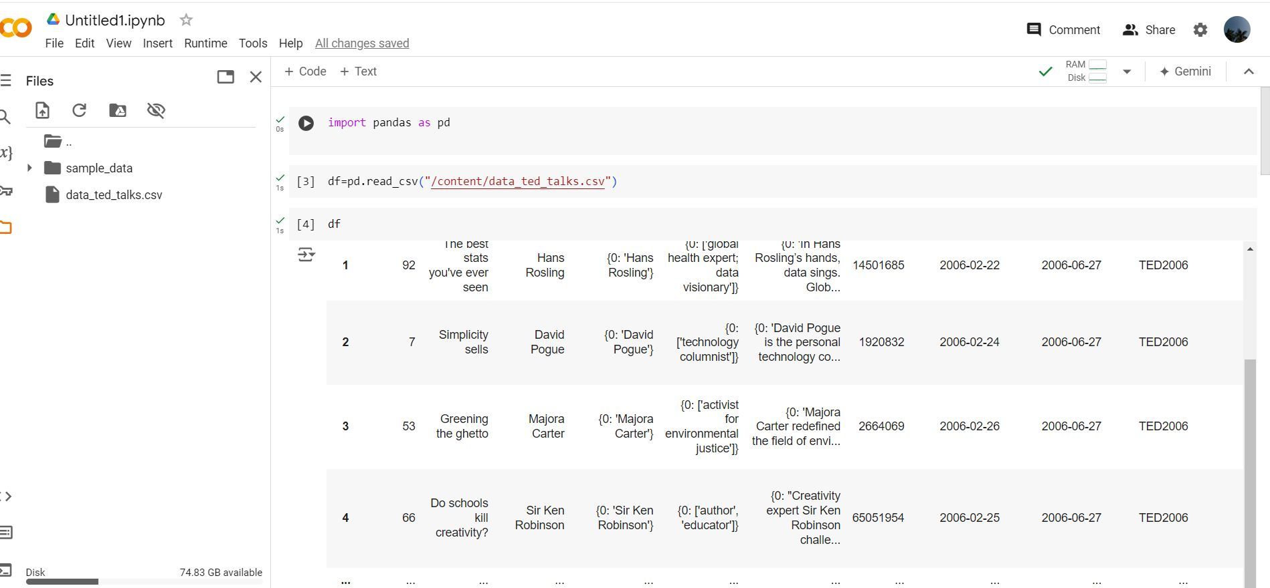
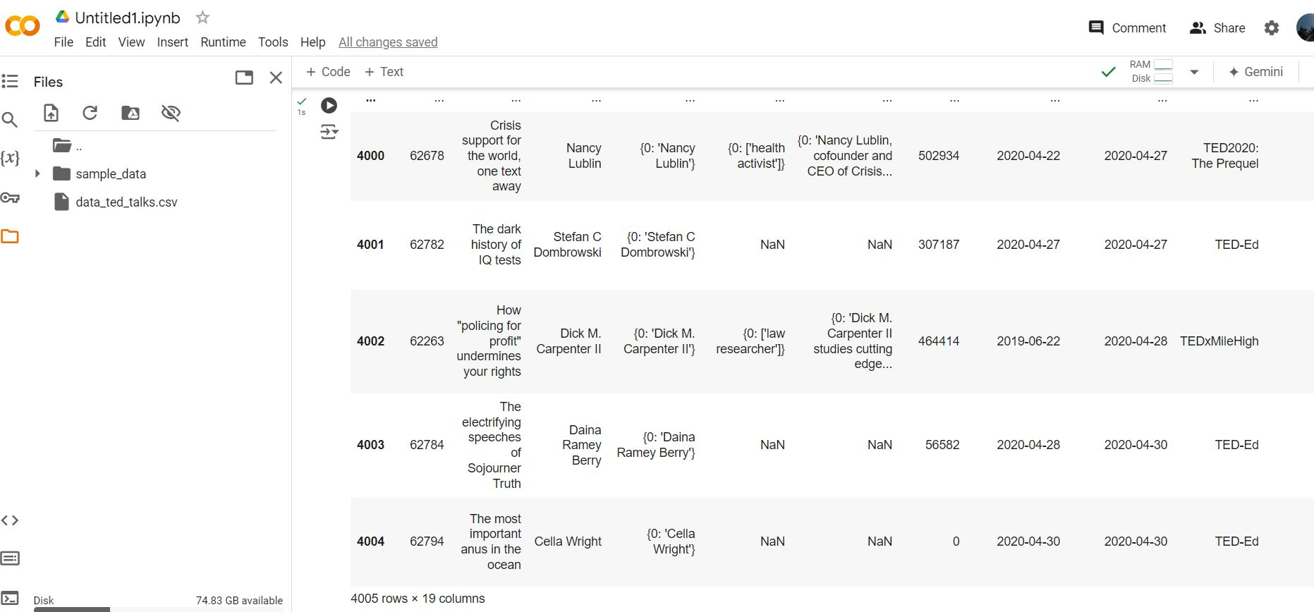

Data of the ted talks

Slide 5
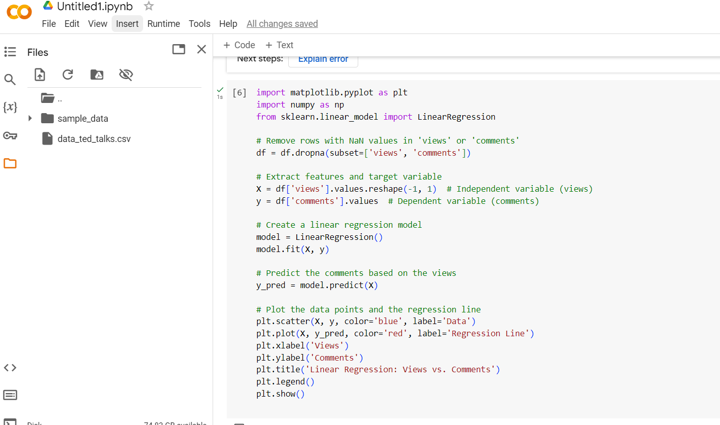
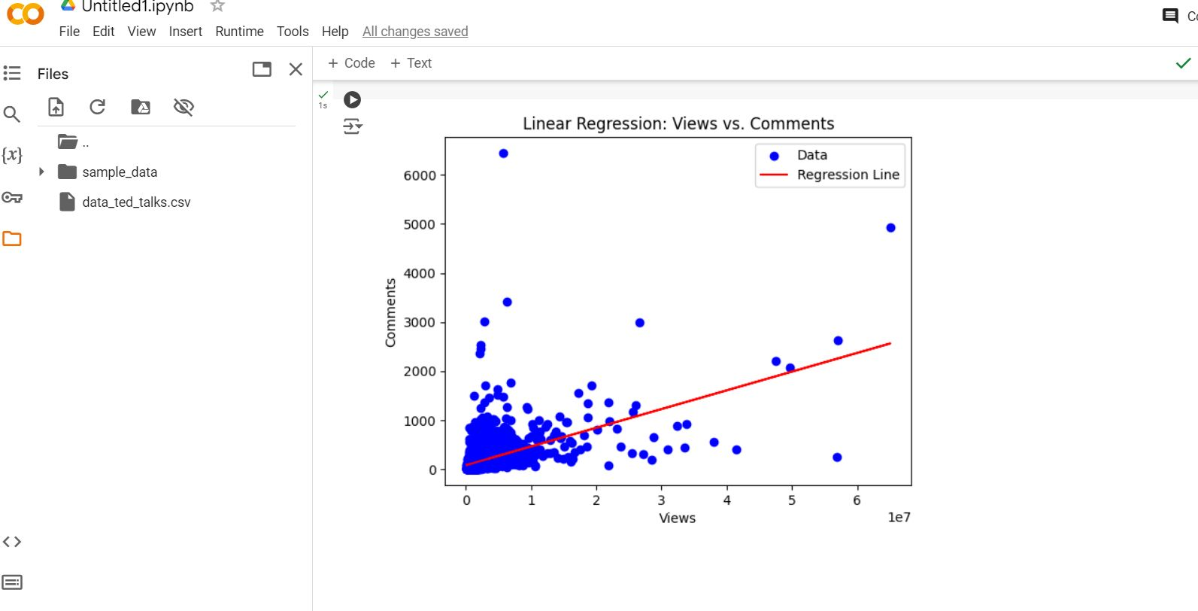

Python code and the result

Slide 6
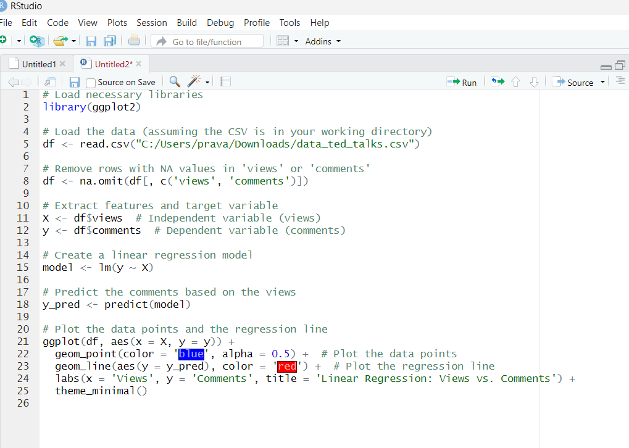
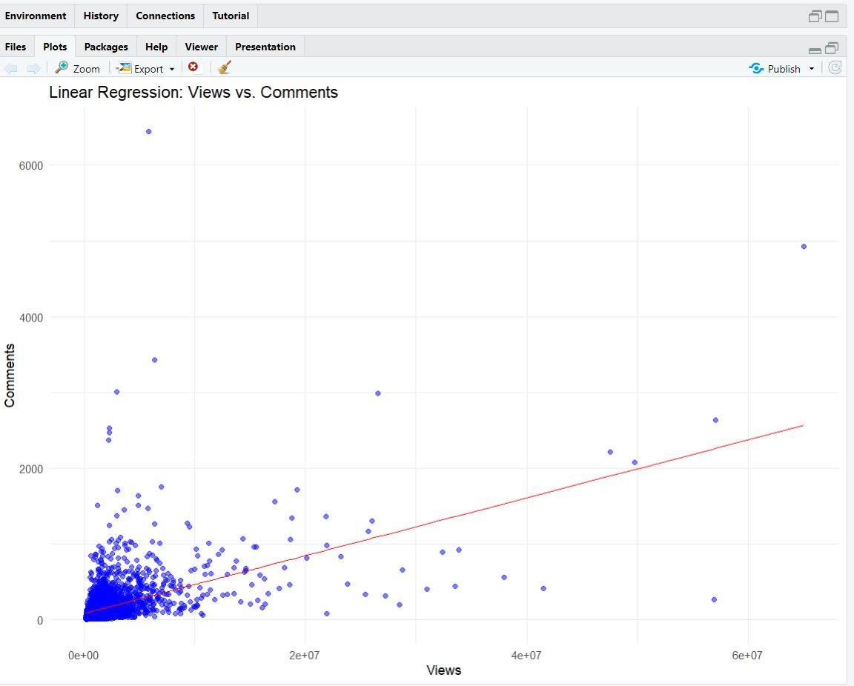
R code and the result

Slide 7


